Slide 1
Broker Training 2024 Quarter 3
Broker accreditation training
Part 1 of 2 sections towards Product 2025 accreditation
Note: For new broker product training please contact brokertraining@sizwehosmed.co.za

Slide 2
CONTENT
SCHEME HIGHLIGHT
CARE CO-ORDINATION
BUSINESS DEVELOPMENT
BROKER ACCEDITATION
.
This summary overview presentation is for Sizwe Hosmed Medical Scheme product information purposes only, it is not advice and does not supersede the registered benefits, rules and managed care protocols of the Fund. View full benefit guide at www.sizwehosmed.co.za

Slide 3
SCHEME HIGHLIGHT
Your Choice for Quality Care
Credentials
Value Proposition
Overview Plans

Slide 4
CREDENTIALS
Provisional subject to audit
Your Choice for Quality Care
137 620 lives covered
57 890 members
Average Age 35.01
Pensioner Ratio 8.93%
Client environment:
Corporate, SALGA, SOE, Private
7 Walk in Centre's
17 Corporate Account Managers

Slide 5
VALUE PROPSITION
Rich benefit options. Value for money.
Clear in structure.
Over 80 years combined experience in the Industry
Sound procurement partner
Global Credit Rating
A
Affordable child rate, charged up to 26 years of age. Family friendly contribution
Comprehensive Wellness & Chronic care benefits on all plans
Savings plans with a difference
Pay for a maximum of 3 child dependants
Annual overage child review from the age of 21 years

Slide 6
OVERVIEW PLANS
11 plans to choose from
Efficiency Discounted Option (EDO)
Choose an EDO plan and enjoy the same rich benefits accessed within a network of service providers for In and Out of hospital
 | ESSENTIAL COPPER | ACCESS CORE | ACCESS SAVER | GOLD ASCEND & EDO | VALUE CORE & EDO | PLATINUM ENHANCED & EDO | PLUS | TITANIUM EXECUTIVE
Plan Structure | Fully Networked – Primarily PMB | Hospital | Savings 25% plan | Traditional | Traditional | Hybrid (MSA + SPG+ ATB) | Traditional | Hybrid (MSA + SPG+ ATB)
Hospitalisation | PMB Cover | Unlimited 100% Scheme Rate | Unlimited 100% Scheme Rate | Unlimited 100% Scheme Rate | Unlimited 100% Scheme Rate | Unlimited 100% Scheme Rate | Unlimited with procedures at 200% Scheme rate | Unlimited with procedures at 300% Scheme rate
Network Hospitals | Applicable | Applicable | Applicable | EDO option only | Core option only | EDO option only | N\A | N\A
Chronic | 27 PMB | 27 PMB | 27 PMB | 27 PMB | 27 PMB + 18 Non CDL | 27 PMB + 26 Non CDL | 27 PMB + 25 Non CDL | 27 PMB + 33 Non CDL
Day to Day \ Savings Account | Within Network | N\A | MSA | Day to Day | Day to Day | MSA - SPG - ATB | Day to Day | MSA - SPG - ATB
Dentistry | Conservative | N\A | Conservative | Conservative | Conservative & Specialised | Conservative & Specialised | Conservative & Specialised | Conservative & Specialised
Optical | ✓ | N\A | ✓ | ✓ | ✓ | ✓ | ✓ | ✓
Wellness & Maternity | ✓ | ✓ | ✓ | ✓ | ✓ | ✓ | ✓ | ✓
Other Benefits | N\A | N\A | ✓ | ✓ | ✓ | ✓ | ✓ | ✓
11 plans to choose from
To view full benefit guide please visit www.sizwehosmed.co.za

Slide 7
NETWORKS
Structure
Networks
Plan Name | Plan Type | Plan Structure
Titanium Executive | Hybrid \ Savings | Member Savings Account (MSA) Self Payment Gap (SPG) Risk Above Threshold Benefit (ATB)
Platinum Enhanced & EDO
Plus | Traditional | Risk Benefits Separate basket of benefits
Value & EDO
Gold Ascend & EDO
Access Saver | Savings | Risk Benefits Member Savings Account
Access Core | Hospital | Hospital Benefits
Essential Copper | Fully Networked | Risk Benefits within networks
Plan | Network Hospital | Optical Network | Dental Network | GP & Specialists Network
Titanium Executive |  | Isoleso | Dental Risk Company
Plus
Platinum Enhanced
Platinum Enhanced EDO | 3SixtyHealth Network |  |  | 3SixtyHealth Network
Value
Value Core EDO | 3SixtyHealth Network |  |  | 3SixtyHealth Network
Gold Ascend
Gold Ascend EDO | 3SixtyHealth Network |  |  | 3SixtyHealth Network
Access Saver | 3SixtyHealth Network
Essential Copper | 3SixtyHealth Network | 3SixtyHealth | 3SixtyHealth | 3SixtyHealth Network
Comprehensive
Medium to Rich
Cost Effective
Hospitalisation Admissions for elective procedures must be pre-authorised 72 hours before the admission date.
A 30% penalty will be imposed for non-emergency late pre-authorisations.
Emergency admissions must be notified to the Scheme within 48 hours of admission to hospital. Elective use of non-network hospitals will result in a 30% co-payment
A 20% co-payment is applicable if a day procedure is performed at an Acute hospital. 30% co-payment will apply for consultations outside the DSP Network
Unused member savings amounts accumulate year to year and are refundable should member resign a savings type plan (A minimum four month claims run-off waiting period is applicable)

Slide 8
CARE CO-ORDINATION
Your Choice for Quality Care
Quro Med
CureVida
Global Case Management
Voice of the Patient
Europ assist
Neck & Back
Fraud & Risk

Slide 9
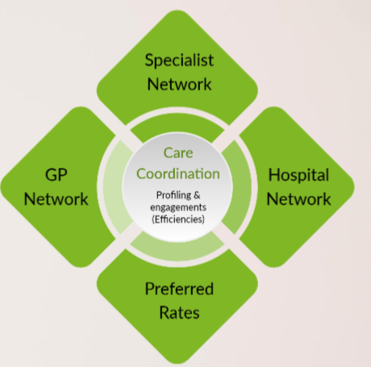
INTRODUCING
CARE CO-ORDINATION
Extending Managed Care Initiatives
Care co-ordination is a crucial element that unites specialists, primary care physicians and other healthcare professionals ensuring every facet of a patients care is harmoniously interconnected and communicated amongst the healthcare team.
Care coordination extends to encompass additional services such as home healthcare through trusted partners, Cure Vida and Quro Medical.
This paves the way to improved outcomes and patient experience.
Delivering comprehensive, accessible, patient-centered, quality healthcare, at negotiated cost-effective rates

Slide 10
CARE CO-ORDINATION
In partnership with
Quro Medical, CureVida, Global Case Management and Insight Health Solutions
3Sixty Health Authorisations and Case Management
Case manager identifies patient candidate and refers
Care partner contacts member and their Dr
Care Partner facilitates home care authorisation
Global Case Management
Holistically oversee all care partners
Speak with hospital, member, nurses, Drs
Coordinate feedback, make recommendations
Liaise with 3Sixty Health and report
Quro Medical
Primary treating doctors can opt in or out of oversight
Home-based healthcare and remote patient monitoring utilizing a SAHPRA-approved wearable medical device
24/7 complete vital sign monitoring by a multidisciplinary team
Improved recovery and reduced risk for vulnerable patient groups
Clear communication and feedback with members and treating doctors
CureVida
Provides nursing \ care services in the comfort of your home
Successful for care of patients in lieu of hospital : examples
wound care and dressings in diabetic patients
Selected respiratory diseases and IV drip administration
Communication and feedback to members Dr
Recuperate in the warmth and familiarity of your own home, with support from loved ones
Decreased risk of hospital-related infections and reduced mental stress
Advantageous for vulnerable members such as those managing chronic conditions and the elderly

Slide 11
INTRODUCING
VOICE OF THE PATIENT
Voice of the Patient (VOP)
Seeks to measure, analyze and report on what matters to patients, our members in the healthcare system, by engaging with member patients directly
High quality medical care is also effective, safe, timely, and efficient
Hospital Experience Surveys
After hospital admissions, members may receive a request from Voice of the Patient to participate in a survey
The survey will ask about aspects of hospital care relevant to almost everyone, such as how you were treated by doctors and nurses, whether the hospital was clean and quiet, whether help came promptly when needed, whether pain management was provided, and if important information was communicated to member
Condition Specific Surveys
Sent prior and after admissions for hip and knee replacements, colonoscopies, maternity admissions and cardiac admissions. These surveys will focus on your state of health and specific aspects of your condition and will help us determine how well the treatment you have received has met your needs.
Results of the surveys
Enable assessment and identification of gaps in patient care and where improvement may be possible.
Over time, the Scheme will be able to provide information to you about which hospitals provide a better patient experience.
With your consent, and based on your participation, we hope to introduce more opportunities for you to provide these important inputs.
Individual member identity and results will not be disclosed or reported and information at this level is treated as confidential
Voice of the Patient is a service provided by Insight Health Solutions. For more information about VOP, see: https://voiceofthepatient.co.za/
email address: surveys@insight.co.za

Slide 12
EUROP ASSIST
CALL 0860 11 77 99 – Number is on membership card
Emergency Medical Response Service (EMS) is available 24/7/365
Provides access to an independent network of roughly 5,000 emergency medical personnel
A 24-hour healthcare service providing members with unlimited access to professional telephonic guidance and support from experienced nurses.
Trauma, Assault and HIV support service is a 24/7 facilitation/call centre designed to deal with emotional shock as a result of assault or suspected HIV infection.
Scenarios uncovered are listed, but not limited to the below
Transportation to Drs rooms, clinics, any place that is not registered as a hospital with 24 hour trauma facilities and overnight accommodation
Transportation home or to a non-clinical place of residence
Transportation for pre-planned events (Including renal dialysis)
Inter facility transfers without pre-authorisation
Bypassing the closest appropriate facility
Claims Adjudication Guidelines
Claims submission via claims portal or paper claim to ambulanceclaims@europassistance.co.za

Slide 13
BACK AND NECK
managed through care partner CMD physiotherapy
PROGRAMME
Designed to work through a multi-disciplinary team to
Help manage chronic back and neck pain
Improve quality of life
Receive ongoing support and homecare plan to optimize recovery
Avoid risky back surgery
FUNDING
Scheme Risk covers this treatment plan for qualifying enrollments
Note this excludes, X-rays, scans & prescribed meds – this will be from members available day to day benefits
TREATMENT PLANS CATEGORISED BY ASSESSED RISK
Low – 3 to 4 weeks
Medium – 4 to 6 weeks
High – 6 to 8 weeks
Enroll – Referral to nearest centre
authorisations@sizwehosmed. co.za
Call 0860 101 176
Baseline Assessment
In conjunction with referring provider and Physiotherapist
Individualised treatment plan
May include Physiotherapist and biokineticist
The intention of the programme is to restore normal function and reduce pain

Slide 14
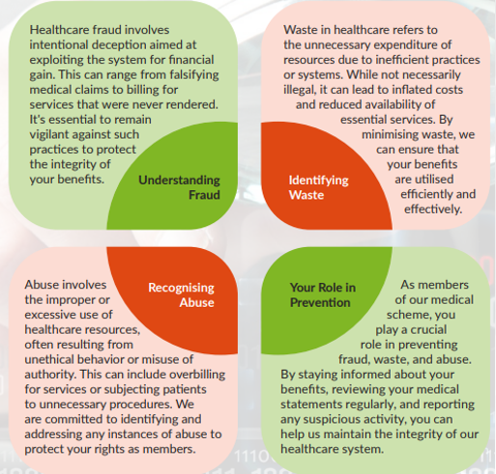
FRAUD & RISK
Member Education
Members play a crucial role in preventing fraud, waste or abuse.
Stay informed of benefits by reviewing medical aid statements regularly
Report suspicious activity

Slide 15
BUSINESS DEVELOPMENT
Your Choice for Quality Care
Corporate Account Managers
Employer Wellness Days
Sales & Business Development
The path to broker accreditation for product 2025

Slide 16
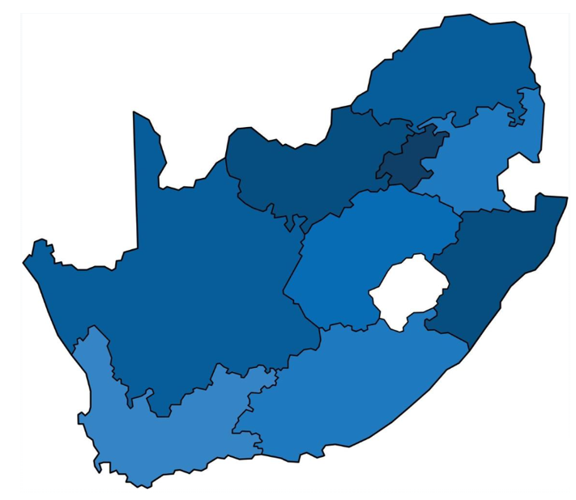
CORPORATE ACCOUNT MANAGERS (CAM)
Lephalale
Shop 11 Stand 2633
Ellisras
X16 Onverwacht
7 Walk-in Centre's
Individual card print
Claim enquiries
Membership enquiries
Submit hard copy papers
Gauteng
23 West Street
Houghton
Johannesburg
Emalahleni (Witbank)
71 Mandela Drive
Cnr Plumer & Mandela Drive
Emalahleni
Kwa-Zulu Natal
19 Hurst Grove
Clifton Grove
Musgrave
Durban
17 CORPORATE ACCOUNT MANAGERS
Appointed to groups > 20 members
In support of brokers and client HR \ Mgt escalations & feedback
Inductions, member product education, on-site sign-ups
Provide broker management reports
Present client reports at healthcare committee level
Wellness days, focused wellness approach
Broker \ Client specific initiatives towards growth
Welcome
Corner House
Cnr Buiten & Graaf Street
Welkom CBD
Cape Town
7th Floor
Norton Rose House
8 Riebeek Street
Cape Town
Gqeberha
Ground Floor, Block E
Southern Life Gardens
70 – 2nd Avenue
Newton Park
Call Centre 8:00 to 17:00 weekdays – 0860 100 871
Walk-In centers 8:00 to 16:30 weekdays (Excl PH)
Pharmacy on-line Realtime claiming 365\7\24
Emergency Ambulance Service 365\7\24

Slide 17
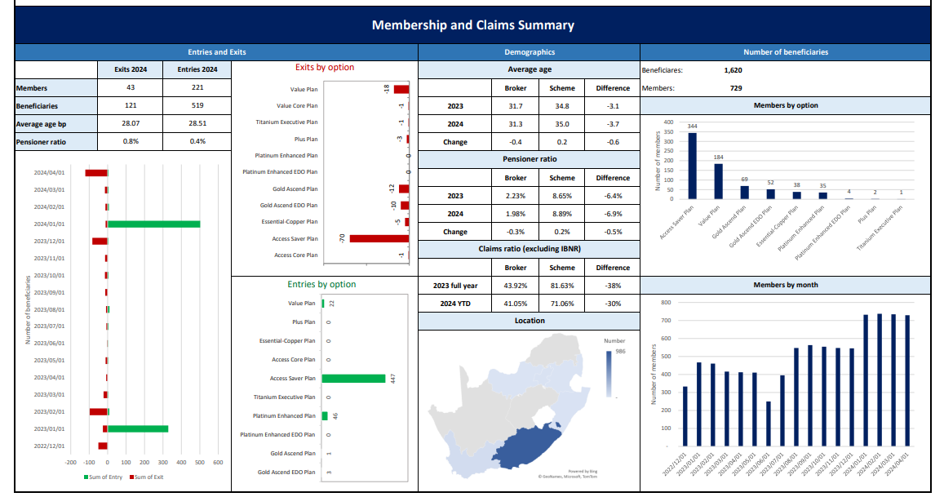
BROKER MANAGEMENT REPORT
Brokerage Overview Report
Example of a Brokerage Overview report – Available on request from the 18th of each month
Provides an overview of your brokerage book within the Scheme
Entries and exits YTD
Average age
Pensioner Ratio
Option take up or exit
CVB ratio
Regional base
Total membership
Plan distribution
request from your Corporate Accounts Manager – Provide your brokerage name and code

Slide 18
EMPLOYER WELLNESS DAYS
Groups > 25 Scheme members
Complete the wellness day request form and select the screening tests required.
Submit to the Corporate Account Manager (CAM) for that employer group.
Requests for events/campaigns must be sent 4 weeks prior to the anticipated date of event.
Requests are subject to Scheme approval
Please supply your employer Scheme registration number (as found on employer billing statement)
The employer to provide resources to assist with setting up at the venue.
Where the testing requested to include HIV screening, a separate, private area is required at the venue.
The Scheme Health Day times are scheduled to run between 08h00 – 15h00. Where shifts are applicable, please be sure to advise what the shift times are and the process to access the premises during these times. Please note this is subject to special arrangements being made as there are cost implications for teams being made available after hours ,of which, if any, applicant will be advised.
If the turnout is less than 25 on wellness event day, the company will be liable for payment of each member that did not attend up to the value of 25 members.

Slide 19
SALES & BUSINESS DEVELOPMENT
Focus on Broker Partners – Update on Activities Underway
Q1 & 2
Stakeholder Roadshow – departmental service alignment & Scheme update
Broker Information Guide
Analysis and review of 2024 broker accreditation process
Dedicated coordinated training
Dedicated new business prospecting & provisional quote assistance
Broker Portal - Stakeholder interviews
Q3
Broker accreditation enhancements towards training and product 2025 accreditation
Member access to care guide
Portal enhancements
Broker client reports review, standardize and enhanced delivery
Preparation of trade presenter and OWP sales pack
Employer OWP Information pack
Employer Group Roadshows
Q4
Year end reviews and final accreditation training

Slide 20
Quarter 3 (2024)
Thank you for attending Q3 broker accreditation training
Go to www.sizwehosmed.co.za
Receive this presentation or review the deck on the website
Access Q3 on-line accreditation assessment and complete
Receive immediate feedback on the results
Up to 3 attempts are available, thereafter request refresher training
What's Next!
Q4 Broker product 2025 accreditation Training
PRODUCT CHANGES 2025
Complete Q3 and Q4 assessments and your Product 2025 Accreditation will be finalized
brokertraining@sizwehosmed.co.za

Slide 21
THANK YOU FOR YOUR CONTINUED SUPPORT

